Slide 1

WELCOME

Slide 2
Case Study of HR Sevices

Slide 3
Some of the use cases of HR Automation
Employee onboarding
Off boarding
Leave requests
Expense claims
Employment history verification
Candidate sourcing
Payroll
Tax filing
Employee benefits
Time management…….etc

Slide 4
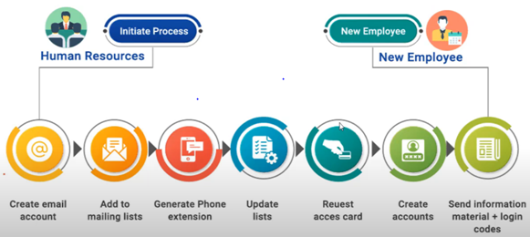
Employee on-boarding : AS-IS

Slide 5

Employee on-boarding: AS-IS
Manual Data Entry
Email co-ordination
Straight through processing
High Lead Time

Slide 6
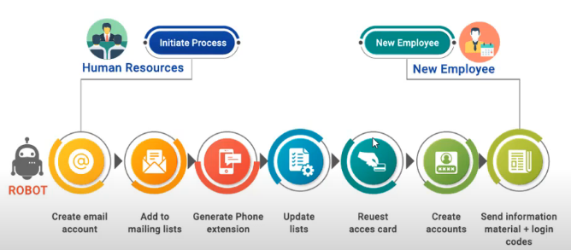
Employee on-boarding : TO-BE

Slide 7
One Case Study –Employee Onboarding
Challenges:
One of the leading Healthcare RCM BPO has 500 new joining every month across different cities and has been facing challenges coping up with the manual, day to day employee on boarding tasks, which is not only time consuming but repetitive in nature

Slide 8
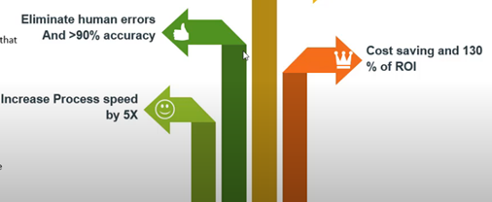
Our Solution
Implement RPA based automation RPA bots that performs:
Read relevant documents
Create email accounts
Add employee to mailing list
Generate Phone extension.
Request Card.
Create AD accounts.
Scrap employee details and push to System
Send employment and login details to employee

Slide 9
Conclusion
The repetitive tasks in HR on boarding should be Automate
by RPA by using different tools like UIPATH ,Blue Prism
Automation anywhere…etc

Slide 10
Other Information about use case
Industry Categories for this use case: Compliance , HR.
Skill Level Required : Intermediate.
UI Path Products that were used: UI Path Studio, UI Path APPS, UI Path Orchestrator.
Other Applications that were used: Office 365 , Chrome.

Slide 11
THANK YOU

